Slide 1
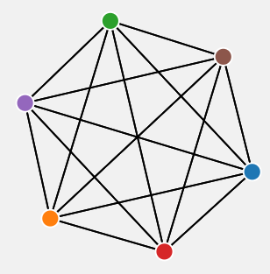
Maker-Breaker Triangle Game
Chandranshu Gautam
1901846

Slide 2
Maker-Breaker Triangle Game
Two-player mathematical combinatorial game that involves creating and restricting the formation of triangles on a complete graph.
For n,q ∈ N, the (n,q)-triangle game is played by two players- Maker and Breaker, on a complete graph K_{n} , where n is the number of nodes and q is the number of moves for Breaker in each chance.
Alternately, Maker chooses one vertex/edge and thereafter Breaker chooses q vertices/edges.
The objective of the Maker is to complete a triangle consisting of his/her choices whereas the Breaker needs to stop the same.
The Maker wins the game if he claims all the edges/nodes of a triangle otherwise the breaker wins.
The game requires strategic thinking and mathematical skills, as players must analyze the graph and anticipate their opponent's moves in order to respond effectively.

Slide 3
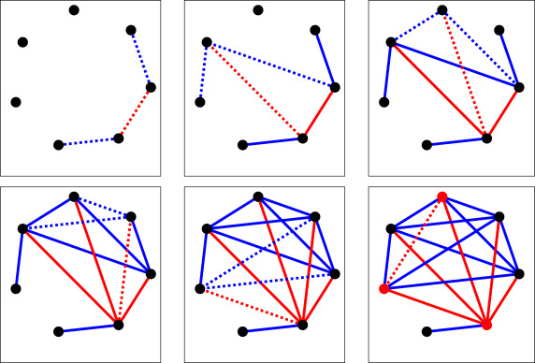
A (7,2)-Triangle game. Maker-edges are red and Breaker-edges are Blue.

Slide 4
What is the Open Question?
The objective of the Maker is to claim the edges in such manner that a triangle is formed in K_{n}.
On the other hand, the Breaker’s objective is to restrict the Maker from making the triangle by selecting the edges in an intelligent manner.
If the Maker manages to build a triangle, he wins the game, otherwise Breaker wins.
In this game, a draw is not possible. In each Maker-Breaker game, either Maker or Breaker wins.
The main research question about these games is to determine optimal strategy for both. This game has got considerable attention.
In the complete graphs with n > 4, for q = 1 Maker can always force a victory with optimal gameplay. On the contrary, for q = n − 1 this is a breakers win. The question is for what value of q does this switch happen? Is there any constant factor below which it’s a Maker’s win and above which Breaker has a winning strategy?

Slide 5
Range of Uncertainty
Chvátal and Erdős proved that in the game on complete graphs, Maker has the winning strategy if q < √(2n + 2) – 5/2 ≈ 1.414√n, and if q ≥ 2√n, then the Breaker has a winning strategy. After that the problem of finding the exact leading constant became a matter of interest among the mathematicians.
Balogh and Samotji slightly improved the constant given by Chvátal and Erdős for Breaker’s winning strategy from 2 to 1.935 using a randomized approach.
Glazik and Srivastav presented a new deterministic strategy for Breaker’s win whenever n is sufficiently large and q ≥√ (8/3 + o(1))n ≈ 1.633√ n, significantly reducing the gap towards the lower bound.
But finding a leading constant value for q before which it is Maker’s win and beyond which it is Breaker’s win is still an open Question.

Slide 6
Breaker’s Strategy Development
The Breaker should first check if any loop of the maker is just one edge away i.e. if any of the path is of length 2. If this situation holds true, Breaker should claim that edge.
If there is no loop for the Maker which is just one edge away, Breaker should claim the edge originating from one of the maker’s nodes.
Breaker should select the edges with one of the nodes having comparativly more of the Maker’s edges than the others and containing less number of edges that are already selected by the Breaker. But this should be considered secondary to the first point.
Maker can win by fixing a node v & then simply claiming all his edges incident to v. At some point, the Breaker will not be able to close all Maker’s paths of length 2 and that’s why the variable q plays an important role to make this game worthy. Breaker can always close all the paths of length 2 made by the maker & at the same time prevent maker to build a star of size q/2.

Slide 7
More Instincts
The only chance for maker to win the game is to construct more than q paths of length 2 as otherwise Breaker has a strategy to stop him. If maker claim an edge say {x,y}. Then the total paths of length 2 would be deg_{M}(x) + deg_{M}(y). And all these paths are required to be closed by the Breaker.
By considering these factors, we made multiple observations by varying the variables ‘n’ and ‘q’ of the (n,q)-Triangle game for the graph K_{n}. It was ensured to not make any dumb choice.
Dumb Choice - When there is a clear opportunity in front of the player to either make the triangle (in the case of maker) or to close the way in the formation of the triangle (in the case of the breaker) but then also the player chooses to select some other arbitrary edge instead of claiming the useful edge for him, giving a total advantage to the opponent.

Slide 8
Simulator
Two modes of Playing- Node and Edges
Node Mode - Maker will select the first node followed by Breaker selecting the q successive nodes. As soon as Maker has three nodes claimed by him, he wins the game by forming the triangle.
As soon as Maker has three nodes claimed by him, he wins the game by forming the triangle. On the other hand, Breaker in his chances has the goal of selecting as many nodes as he can so that before Maker gets the third chance, he has already selected all the free nodes of the graph.
This “Node” mode of this game is not much of logical thinking but provides the idea about the ‘q’ chances given to the Breaker.
If ‘q’ is large enough that Breaker can claim all nodes before forming the triangle, then it’s Breaker’s win.
On the other hand, if the value of ‘q’ is not sufficient to claim all the free nodes before maker gets the opportunity to claim the third node, then it’s Maker’s win.
So, this mode is giving us the idea about advantage Breaker gets with the value of ‘q’ which is going to be an important factor in the second mode i.e., the edge mode.

Slide 9
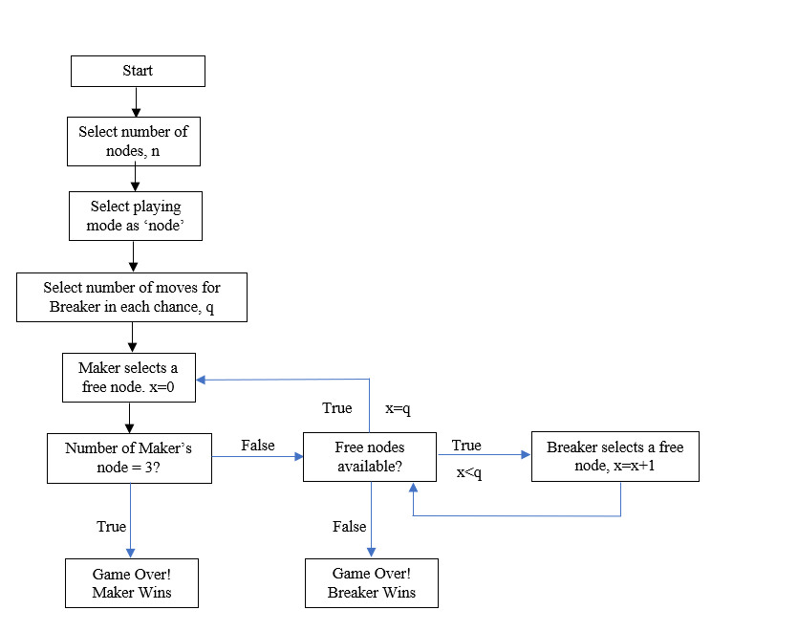
Flow chart representing the Maker-Breaker Game in the ‘node’ mode of simulator

Slide 10
Edge Mode – Played with the rules mentioned in introduction of the game
With the case of edge choice, the maker will have to make the loop by selecting the edges in such a manner that it will form the triangle to win the game. But if before Maker making any triangle, all the available edges get exhausted, Breaker wins the game.
The flow chart is going to remain same in both the cases, whether human-human game or human-computer game.
In the Simulator, players are given the right to select the number of nodes with which they want to play the game.
Say, if players select ‘n’ number of nodes then they can play the game in Nodes mode with n nodes and in Edges Mode with n*(n-1)/2 edges.
After selecting the nodes, players can select the mode they want to play the game with, either Node or Edges.
Also, players can select the number of moves ‘q’ that should be given to the Breaker in each chance.
When these selections are made by the players then the game starts with a complete graph generating and chances given to both the players in respective manner.

Slide 11
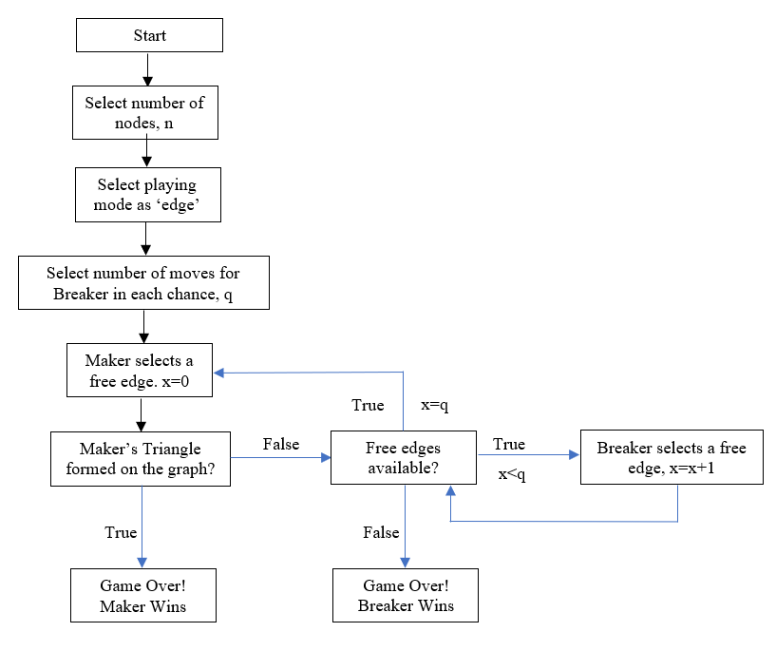
Flow chart representing the Maker-Breaker Game in the ‘edge’ mode of simulator.

Slide 12
Future Scope
The scope of this game is further extended by varying some rules in order to make the players think differently and making correlation between the different variations of the game.
Like, instead of having a complete graph, we have given an option to make a graph consisting of only x% of the edges making the game a little biased.
As the graph keeps getting sparse, the strategy will also vary depending on the position of the edges. Edges could be more densely populated in the one region of the graph than the other or maybe equally distributed
The ratio of edges in one region and the other will impact the players choices by selecting edges more in the region with more number of edges as that’ll be providing more winning chances than making selections in the region with less number of edges.
The simulator will provide all these options for better engagement and development of intuition.

Slide 13
Discussion & Results
After the efforts of Christian Glazik and Anand Srivastav the region of uncertainty for the value of q has been reduced. For q ≥√ (8/3 + o(1))n ≈ 1.633√ n, there is going to be a winning strategy for the Breaker and for q < 1.414 √n, Maker has a winning strategy. But finding a leading constant is still an open question.
Right now, the scope of this game, in context of complete graph, is more or less enough in the case of two-player game with the two independent players playing the game but in the case of Computer-Human the algorithm followed can be improved to make a winning strategy for the Breaker with least possible value of ‘q’.
As the size of the graph increases, it will be difficult for the Breaker to prevent the Maker from making stars of size at least q/2 or preventing him from making more than ‘q’ paths of length 2 in a particular turn.
It is also useful as a pedagogical tool to enable algorithm designers for graph problems to develop better intuition.

Slide 14
References
Christian Glazik and Anand Srivastav, A new Bound for the Maker-Breaker Triangle Game. Dec, 2018. URL: https://arxiv.org/abs/1812.01382
V. CHVÅTAL and P. ERDÖS, Biased Positional Games. 1978. URL: https://www.link.cs.cmu.edu/15859s11/notes/posgame.pdf.
József Balogh and Wojciech Samotij, On the Chvátal-Erdős Triangle Game. 2011. URL: https://www.combinatorics.org/ojs/index.php/eljc/article/view/v18i1p72
Andrew Beveridge, Andrzej Dudek, Alan Frieze, Tobias Muller and Milos Stojakovic, Maker-Breaker games on random geometric graphs. 2014. URL: https://kilthub.cmu.edu/articles/journal_contribution/Maker-Breaker_games_on_random_geometric_graphs/6478268
Fran Blumberg, Kirby Deater-Deckard, Sandra L Calvert and Rachel M. Flynn, Digital Games as a Context for Children's Cognitive Development: Research Recommendations and Policy Considerations. Feb, 2019. URL: https://www.researchgate.net/publication/ Digital_Games_as_a_Context_for_Children's_Cognitive_Development_Research_Recommendations_and_Policy_Considerations

Slide 15


